Slide 4
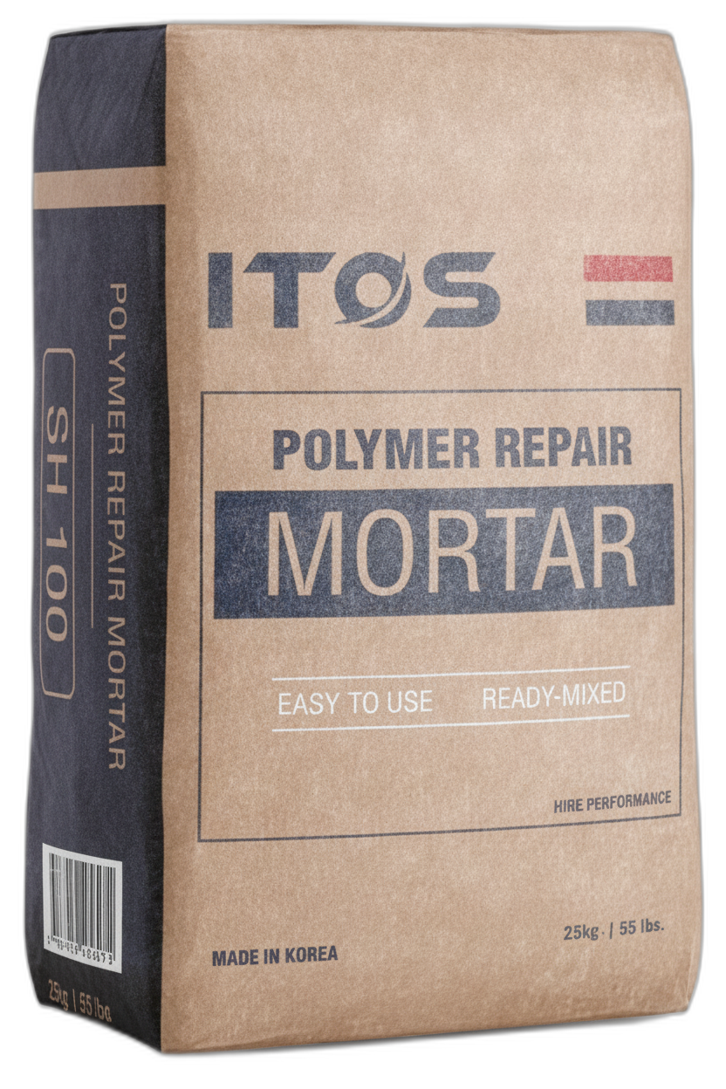

Slide 13
ITOS
13 / 14
Partnership Invitation
Global distributors and OEM principals are invited to build a lasting supply partnership.
13
With six-plus years of export experience and a tested Seoul production line, we invite distributors and import companies to request samples and start a qualification conversation.

